Slide 1
Characterization and Genomic Analysis of the Lyme disease spirochete bacteriophage ϕBB-1
Dominick R. Faith^{1☯}, Margie Kinnersley^{1☯}, Diane M. Brooks¹, Dan Drecktrah¹, Laura S. Hall¹, Eric Luo², Andrew Santiago-Frangos³, Jenny Wachter², D. Scott Samuels¹, Patrick R. SecorID¹*
Ashqul Islam 2/5/2026

Slide 2
Background Info
What is known?
The genome of Borrelia burgdorferi (B. burgdorferi) has a ~900 kb linear chromosome
Has both linear and circular plasmids
Large number of genes encode for outer membrane lipoproteins
Nearly all Lyme disease spirochetes contains the 32 kb circular cp32 prophage plasmid
Additionally a linear lp54 plasmid is present with 1/3 genes paralogous to cp32
When cp32 prophages are induced, they undergo lytic replication to produce the ϕBB-1 virion.
Plasmids encode outer membrane lipoproteins such as the Osp family which facilitate bacterial lifecycle and immune evasion.
In-vivo trigger is bloodmeal and located in tick midgut

Slide 3
Background Info
What is known?
Horizontal transfer occurs in B. burgdorferi but the mechanism is unknown
Phages in general participate in horizontal transfer through transduction and generalized transduction
ϕBB-1 is known as a general transducer of antibiotic cassettes and transduces its own material as well.
Homologous recombination of cp32 isoforms has been found among Borrelia strains
There are known transfer mechanisms for phages including the headful packaging mechanism.

Slide 4
Hypothesis
What will be investigated?
How does Borrelia burgdorferi horizontally transfer genetic material?
Does ϕBB-1 participate in this process?
If so, what genetic materials are transferred?

Slide 5
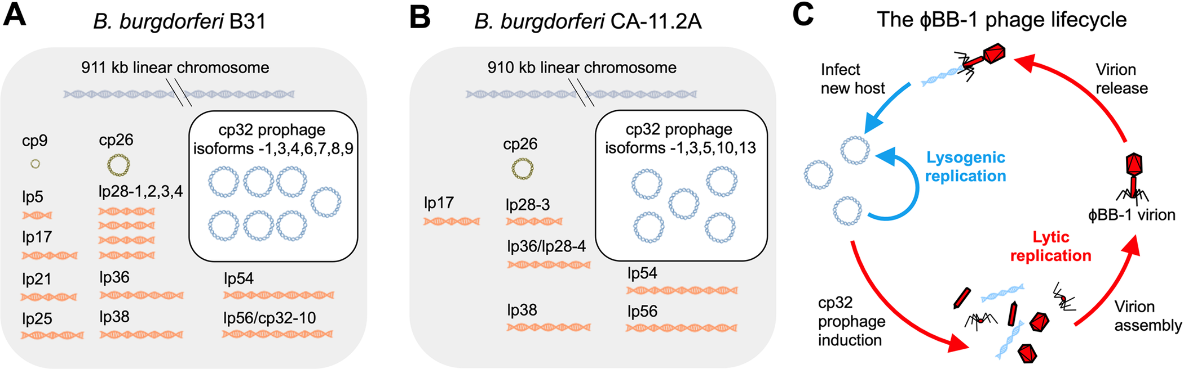
Fig 1. The B. burgdorferi genome is highly fragmented and is composed of a linear chromosome, linear and circular plasmids, and cp32 prophages.
The genomes of B. burgdorferi strains (A) B31 and (B) CA-11.2A are shown. (C) The temperate ϕBB-1 phage lifecycle is depicted.

Slide 6
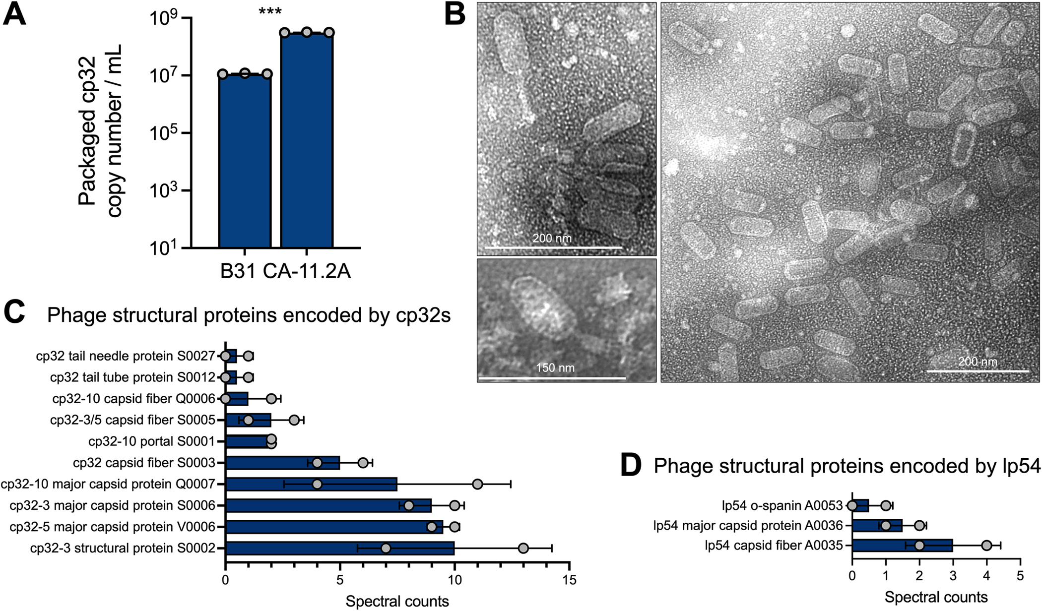
Ethanol to induce
Bacteria removed through spinning
Virion purified by chloroform and ammonium sulfate
Dnase to remove anything not in a capsid
TEM to visualize
Mass spec for proteomics
qPCR to measure cp32 copies
Highest abundance proteins include OspC, OspA, and GroEL
Fig 2. ɸBB-1 phage titer, virion morphology, and proteomic analysis.
(A) Packaged, DNase-protected cp32 copy numbers in bacterial supernatants were measured by qPCR. Data are the SE of the mean of three experiments, ***p <0.001. (B) Virions were purified from 4-L cultures of B. burgdorferi CA-11.2A and imaged by transmission electron microscopy. Representative images from two independent preparations are shown. (C and D) HPLC-MS/MS-based proteomics was used to identify proteins in two purified virion preparations. The SE of the mean of spectral counts for peptides associated with the indicated phage structural proteins are shown for each replicate.

Slide 7
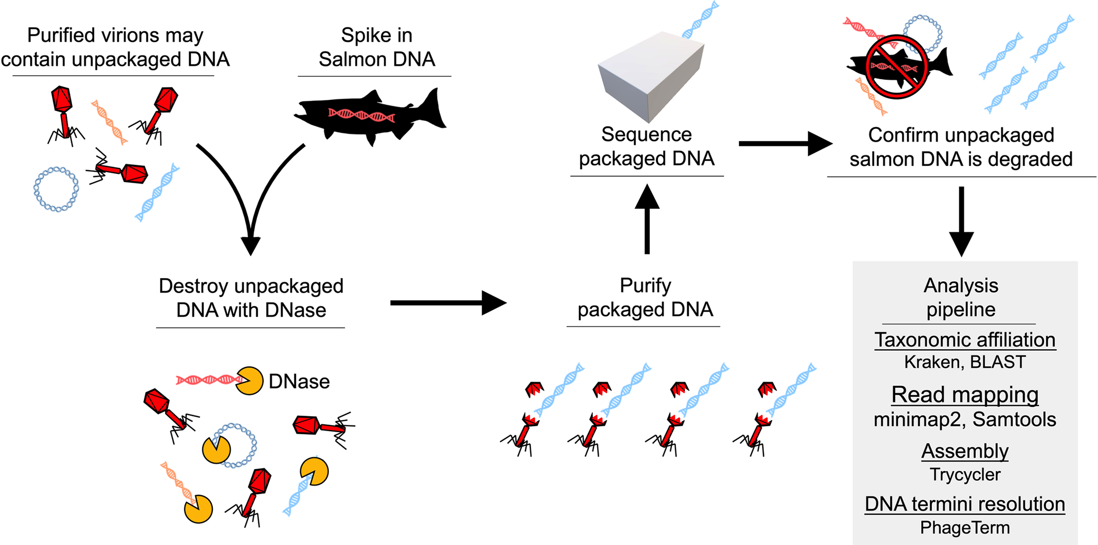
Fig 3. Workflow for sequencing packaged ɸBB-1 DNA.

Slide 8
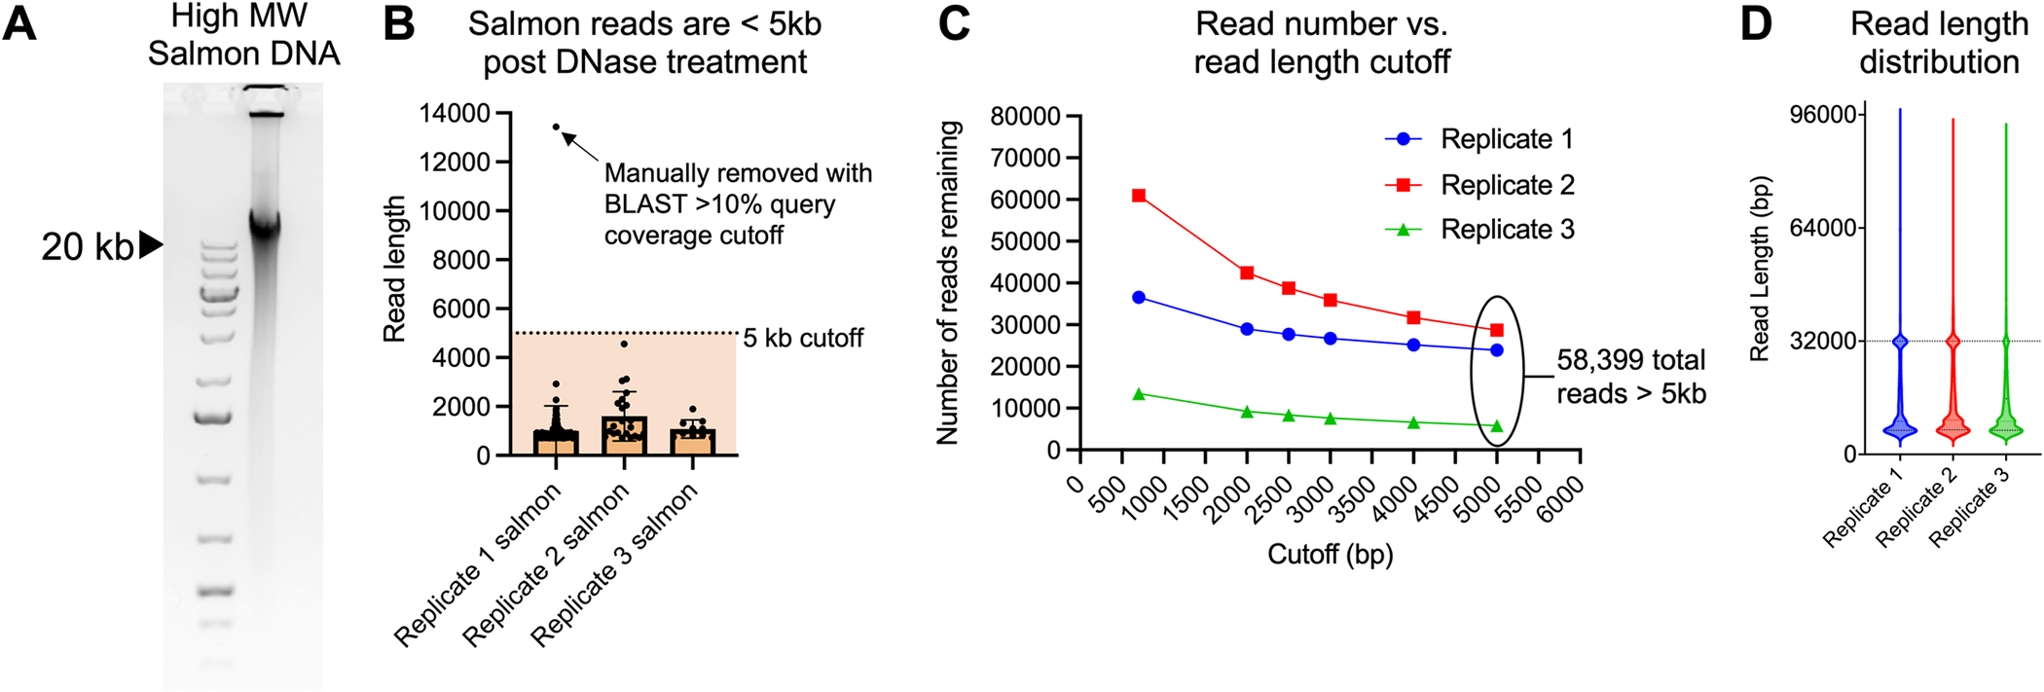
20 kb Salmon sperm DNA
1.7 ug/mL = 3*10^8 Bacterial cells lysed in 1 mL media
DNase incubation
DNA extracted afterwards using proteinase K/SDS/-phenol chloroform
Read on Nanopore MinION
0.14% matched Salmon DNA sequence
Fig 4. Establishing a 5kb read length cutoff to exclude unpackaged reads.
A) The salmon sperm DNA used to spike purified phages prior to DNase treatment was run on an agarose gel to estimate its size. Note that the majority of salmon DNA is larger than the 20-kb high molecular weight marker in the left lane. (B) 0.14% of 110,986 reads > 700 bp, 0.14% were classified as matching salmon sequences. Reads classified as salmon were plotted as a function of their length for each replicate. Error bars represent the SE of the mean of three replicate experiments. All reads except one (arrow) were below 5 kb in length (dashed line) with an average length of 1.2 kb. (C) Read length cutoff was plotted as a function of the number of reads remaining in each replicate dataset. In total, 58,399 reads remain after establishing a 5-kb cutoff. (D) Read length for all reads >5 kb in each replicate was plotted.

Slide 9
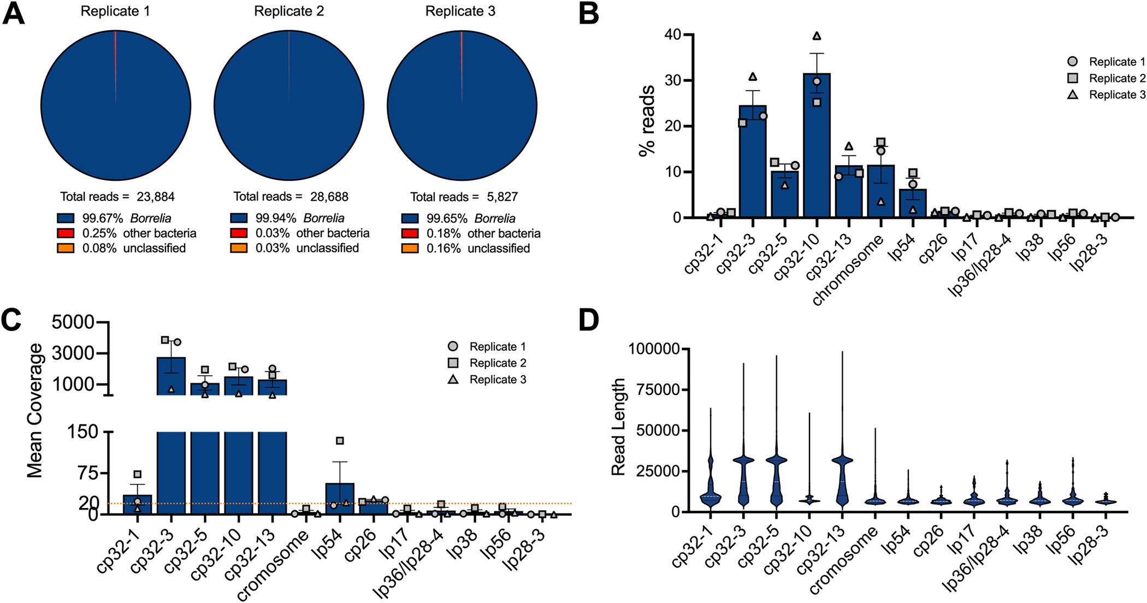
Fig 5. ɸBB-1 virions package cp32 isoforms, chromosome fragments, lp54, and other plasmid DNA.
79% - cp32 isoforms
11.6%- chromosomal
6.3%- lp54
Average length of packaged read for chromosome and other low frequency plasmids are 8kb
(A) Kraken and BLAST were used to determine the taxonomic affiliation of reads >5kb. Note that no eukaryotic reads were identified. (B and C) The (B) percent and (C) mean coverage for reads affiliated with the indicated B. burgdorferi plasmid or linear chromosome are shown for each replicate. Error bars represent the SE of the mean. (D) Read length distributions for the indicated plasmids or chromosome are shown.

Slide 10
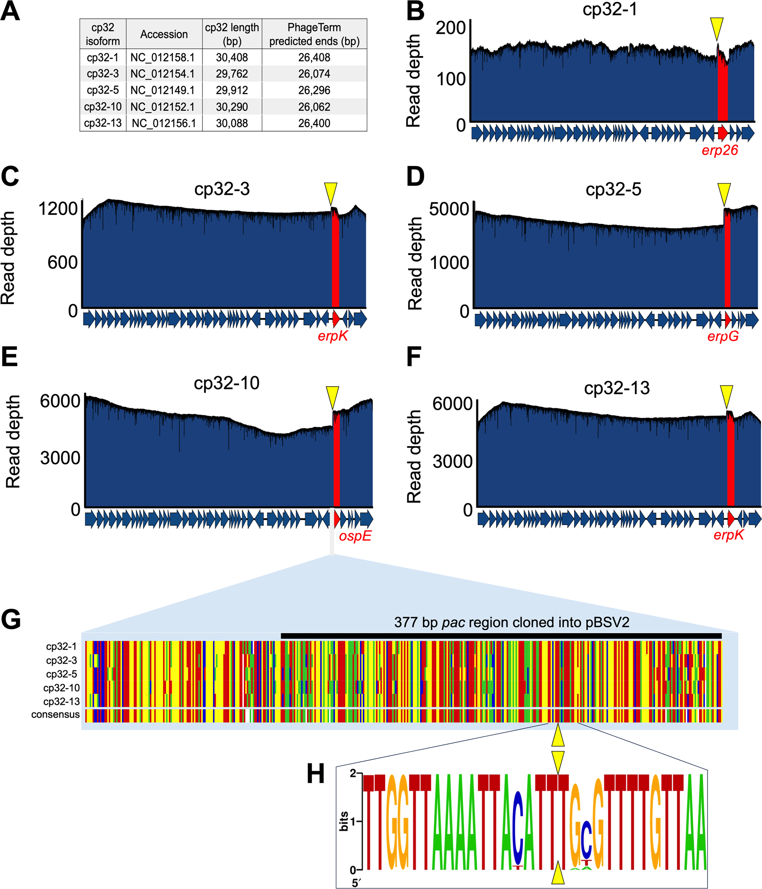
Fig 6. cp32s are linearized upstream of the erp loci.
DNA isolated from ϕBB-1 is thought to be linearized
PhageTerm used to predict the linear ends of packaged cp32s.
Physical end upstream of the erp loci across all isoforms
(A) PhageTerm was used to predict the linear ends of packaged cp32 molecules. (B–F) Nanopore reads were mapped to the indicated cp32s. Note the sharp boundary just upstream of the erp loci (highlighted in red). The yellow triangles indicate the PhageTerm predicted linear ends. (G) Alignments of the intergenic region upstream of the erp loci is shown for each cp32. Colors indicating A, T, C, or G are shown in panel H. The black line indicates the pac region that was cloned into a shuttle vector, as described in Fig 7. (H) A nucleic acid logo was constructed from 207 cp32 sequence alignments. Yellow triangles indicate the linear end of cp32 isoforms as predicted by PhageTerm and confirmed by long-read sequencing.

Slide 11
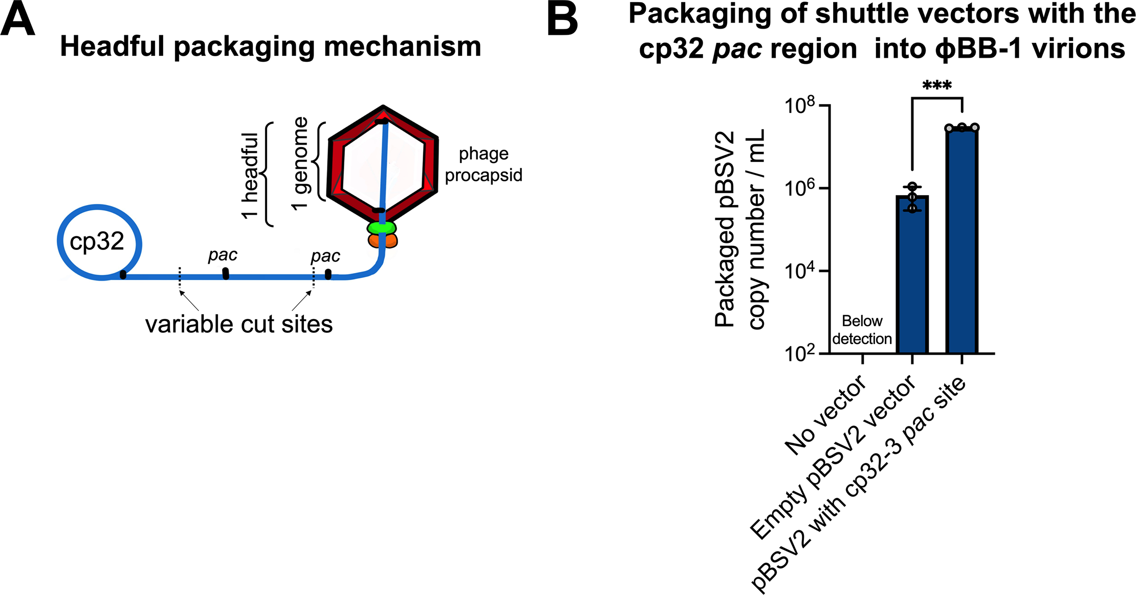
Fig 7. Shuttle vectors containing the cp32 pac region are preferentially packaged into ϕBB-1 virions.
PhageTerm proposed a headful packaging mechanism
Phage generates head to tail copies of their genome
Cut is made at a pac site and headful of linear phage DNA is packaged
Variable cuts follow leading to size variation of packed DNA
pac region cloned into pBSV2 vector, transformed into B. burgdorferi
Followed by induction, extraction, and purification protocol
(A) Schematic depicting the headful genome packaging mechanism. (B) After ethanol induction, ϕBB-1 virions were collected from CA-11.2A cells not carrying plasmid pBSV2 (No vector), cells transformed with empty pBSV2, or cells transformed with pBSV2 with the cp32-3 pac site (see Fig 6G for the cloned pac region). Copy numbers of pBSV2 packaged into ϕBB-1 virions were measured by qPCR. Data are the SE of the mean of three experiments, ***p<0.001.

Slide 12
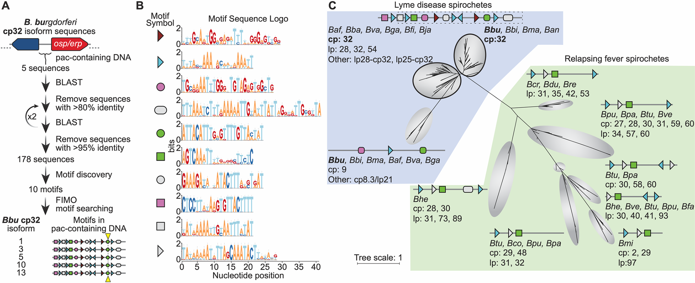
Fig 8. Cp32 prophages have conserved motifs that occur in a specific arrangement around the pac site.
(A) Outline of bioinformatic strategy to identify motifs enriched in the pac-containing DNA sequence of cp32 isoforms. All B. burgdorferi cp32 isoforms have the same motifs in the pac region. The cp32 cut site is indicated by the yellow triangle. (B) Sequence logos of the motifs identified in panel A and schematized in panel C. Nine of the top ten motifs occur at least once in the pac-containing region of cp32 DNA sequences. Motifs represented with right or left facing triangles often occur as direct and/or indirect repeats. (C) Phylogenetic tree of non-redundant DNA sequences with homology to B. burgdorferi cp32 pac-region identified in panel A. For each clade, the bacterial species and type of plasmid are listed. For clarity in the figure, bacterial species names have been truncated to a three letter abbreviation consisting of the first letter of the genus and the first two letters of the species (Borrelia afzelii, Baf; Borrelia andersonii, Ban; Borrelia bavariensis, Bba; Borrelia bissettiae, Bbi; Borrelia burgdorferi, Bbu; Borrelia coriaceae, Bco; Borrelia crocidurae, Bcr; Borrelia duttoni, Bdu; Borrelia fainii, Bfa; Borrelia finlandensis, Bfi; Borrelia garinii, Bga; Borrelia hermsii, Bhe; Borrelia japonica, Bja; Borrelia mayonii, Bma; Borrelia miyamotoi, Bmi; Borrelia parkeri, Bpa; Borrelia puertoricensis, Bpu; Borrelia recurrentis, Bre; Borrelia turicatae, Btu; Borrelia valaisiana, Bva; Borrelia venezuelensis, Bve). There is variability in the motif architecture between sequences within a single clade; however, for clarity, a representative motif architecture discovered by MEME is shown [53]. The top two clades of sequences (outlined in black) are dominated by cp32 isoforms and the cp32 motif architecture, therefore a single motif scheme is shown for these two clades. The region of DNA and motifs cloned into the pBSV2 shuttle vector is outlined in dashes.

Slide 13
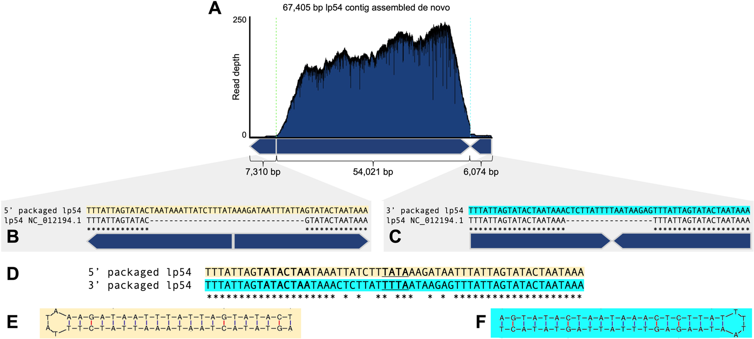
Fig 9. Full-length lp54 with fully resolved telomeres are recovered from ϕBB-1-packaged DNA
lp54 has a tail-to-tail and head-to-head junctions
Read depth dropped at junctions hinting at telomeres
B. burgdorferi telomeres have inverted repeat sequences
Hairpin ends identified
Whether it’s linear lp54 or replication intermediates are unknown
(A) De novo assembly of packaged reads produced a 67,405-bp contig with tail-to-tail and head-to-head junctions. (B and C) Sequences at the packaged 5′ junction (light orange) or the 3′ junction (cyan) are compared to the lp54 reference sequence NC_012194.1. (D) Alignments of the tail-to-tail and head-to-head junctions reveals a variable 18-bp sequence in between the conserved inverted repeats. (E and F) Predicted hairpin structures are shown for each end of lp54. The loop sequence for each hairpin is underlined in panel D.

Slide 14
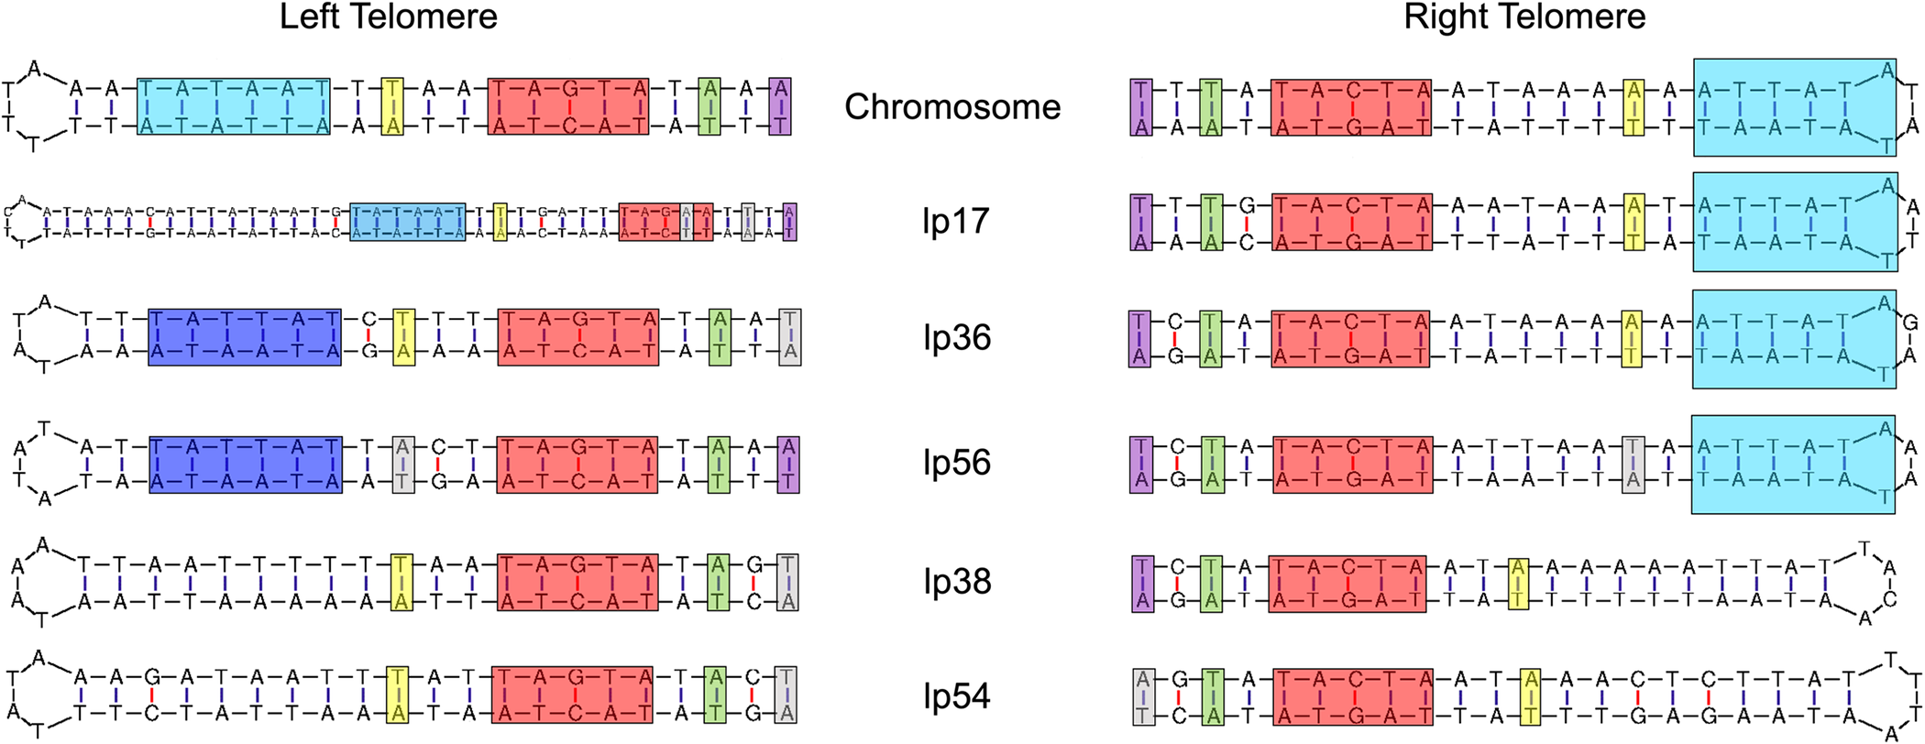
Fig 10. Packaged reads resolve the telomeric ends of the linear chromosome and most linear plasmids in the CA-11.2A genome.
Reads spanning tail-to-tail or head-to-head junctions of the linear chromosome or the indicated linear plasmids form perfect hairpin structures. Conserved regulatory elements for each telomere are highlighted.

Slide 15
Discussion
What New Information was Established?
ϕBB-1 virions package B. burgdorferi chromosome material along with plasmids besides cp32 such as lp54 and cp26.
Packaged cp32 end upstream of the erp loci.
Bacterial and phage DNA are packaged via a headful mechanism at a pac site.
cp32 isoforms share similar motifs around the pac site
Linear plasmids like lp54 are packaged with a covalently closed hairpin telomere site at both the head and tail end.

Slide 16
Conclusion
ϕBB-1 virions are highly implicated in facilitating the horizontal transfer of B. burgdorferi and other Lyme disease-causing spirochetes.
The establishment of an increased uptake of DNA that contain the cp32 pac site by ϕBB-1 bacteriophages can be potentially utilized as a means to integrate other recombinant DNA into B. burgdorferi.
Further investigations could include:
What bacterial genes are most frequently transferred?
Is there a significance for 8kb being the average size read length for bacterial chromosomes and low frequency plasmids?
Can ϕBB-1 transfer between different Borrelia strains outside of B. burgdorferiI?
Can this be replicated in-vivo?

